Slide 2
What are the business functions impacted?
Product and Engineering/R&D- to come up with a unique solution
Legal- to file patents to the products
Human Resources (HR) - to hire new talent or to acquire starups with solutions
Finance- to evaluate ROI on the transformation
Customer Success, Service and Support - to get customer feedback on new features hr to hire engineers(if required), vendors to hire store staff(if required)
Technological innovationis the single mostimportant driver of competitive success in manyindustries. Many firms earn over one-third of saleson products developed within last five years.

Slide 3
What is the operating model and capabilities required by Function? (Process, System, Organizational)
P - Key activities required to execute on business strategy will need the organization to define the process capabilities by business function
S - Process capabilities require digital / system capabilities to be designed and built or developed/configured
O - Process and System capabilities require organizational capabilities around people, process and governance to be designed and deployed

Slide 4
Who should own the program roadmap?
A guy under the leadership
A guy above someone who owns the deliverables and leads individual teams

Slide 5
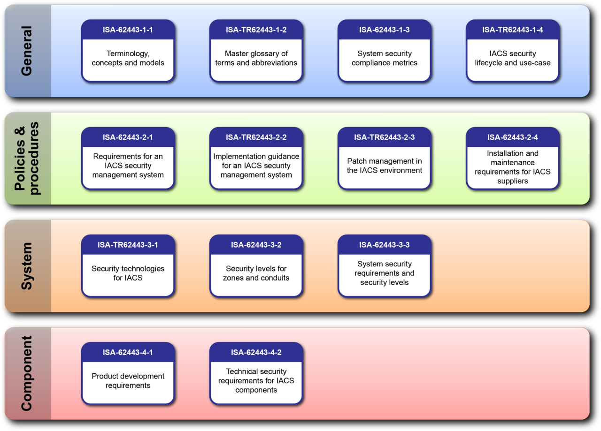
What about Policies: Privacy, Data, Security, integration, etc.?
Get theoretical knowledge from slides about policies and integrate with project
Notes:
https://en.wikipedia.org/wiki/Cybersecurity_standards#/media/File:ISA-62443_Standard_Series_2012.png

